Slide 1


Deep Learning
Project Report
Presented by :
Mohit Sharma
Vineet Kumar

Slide 2
Objective:
Consider a single point load of known magnitude at the top right end of the beam.
Generate the random topologies of the beam by altering the positions, sizes, and quantities of
the holes in a random manner. Use DeepOnet to predict the displacement field and compare
its performance with ANN.

Slide 3



Data Generation
Workflow
Model Creation
Model Fitting

Slide 4


Data Generation

Slide 5


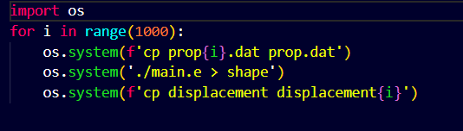
Data Generation
Generating property files:
We obtained a folder containing a file named prop.dat. which contains young’s modulus of each node , to create voids, we give value 5 to that node. Ultimately, we produced 1000 new files. Furthermore, we adjusted the second-to-last line of each duplicated file, setting the Poisson's ratio to 0.33.
Generating displacement files:
Using these 1000 files we generated 1000 displacement files which we will use as output of our Neural Network. Below you can find code snippet for generating these displacement files.

Slide 6
Model
Generation

Slide 7
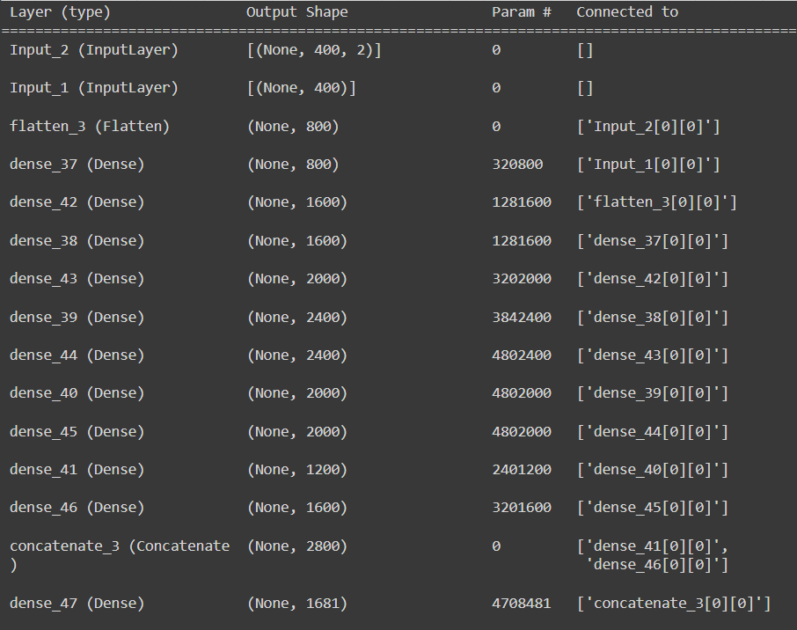
DeepOnet
Model Summary

Slide 8
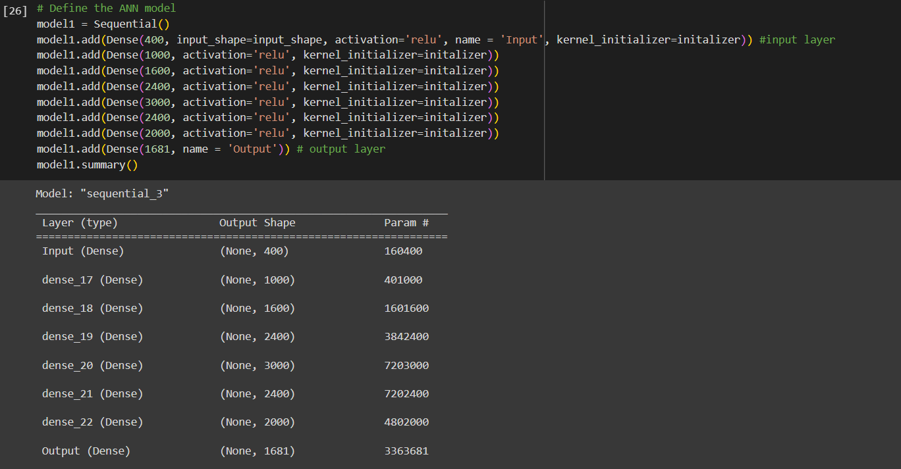
ANN
Model Summary

Slide 9
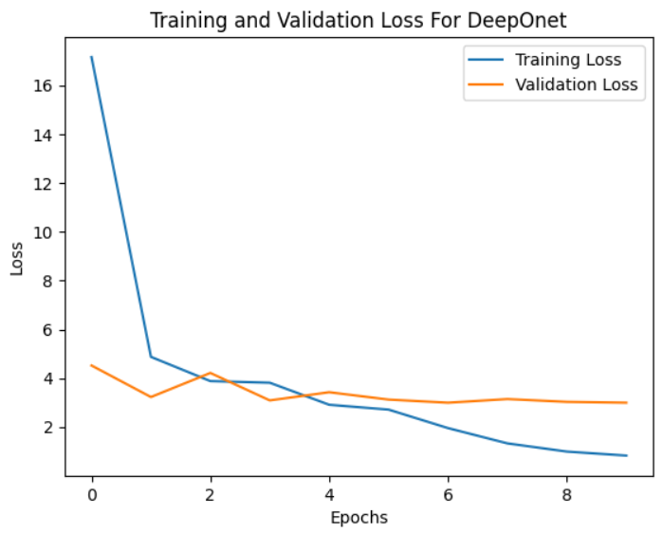
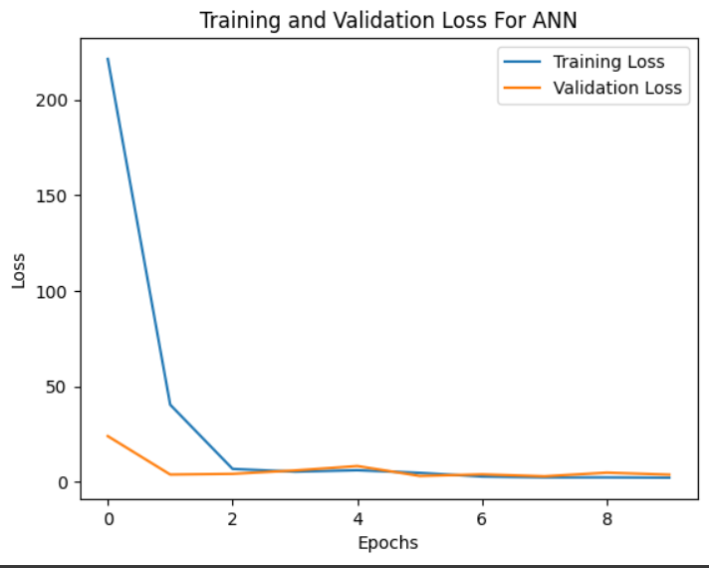
Comparing DeepOnet with ANN

Slide 10
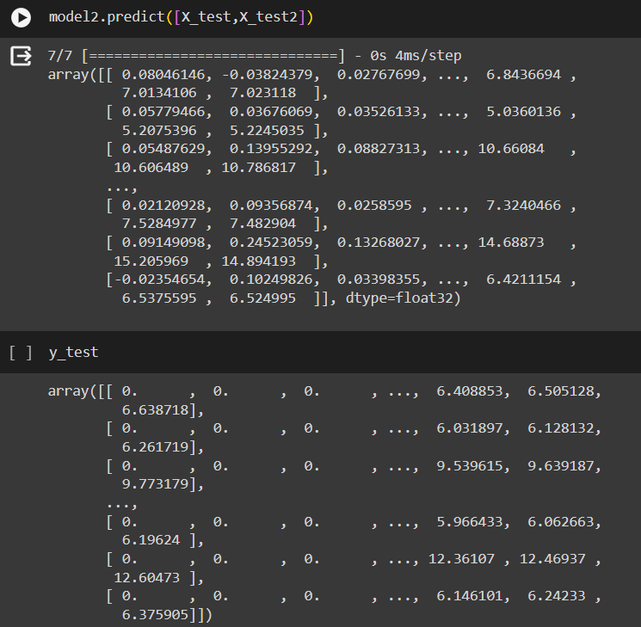
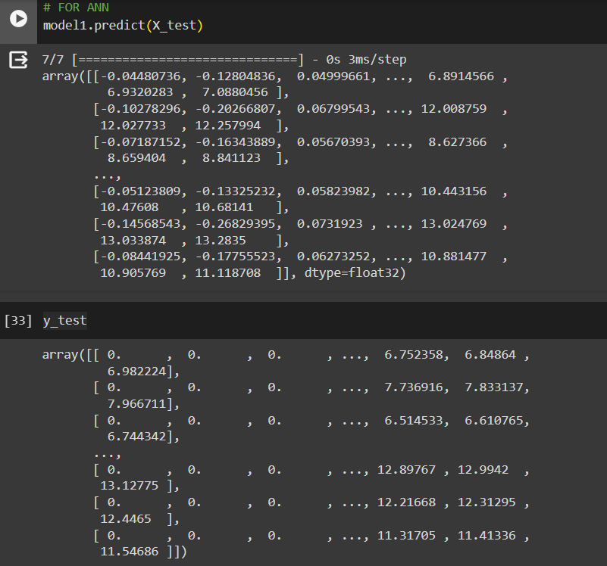
Comparing DeepOnet with ANN
Predictions of DeepOnet
Predictions of ANN

Slide 11


